Slide 1
Security Risk Management – Assessment and Implementation Plan

Slide 2
Security Risk Management
2 attributes :
- Identifying and Prioritizing Security Risks
- Implementing strategies
Goal ? Minimize the likelihood and impact of security incidents
2 parts:
- Assessment : Assets, Threats and Vulnerabilities
- Implementation Plan : Strategies and controls

Slide 3
Assessment
Risk Identification:
Identifying Assets
Identifying the potential Vulnerabilities of these Assets
Identifying Threats
Risk Assessment:
Likelihood
Potential Impacts
Thus, level of risk

Slide 4
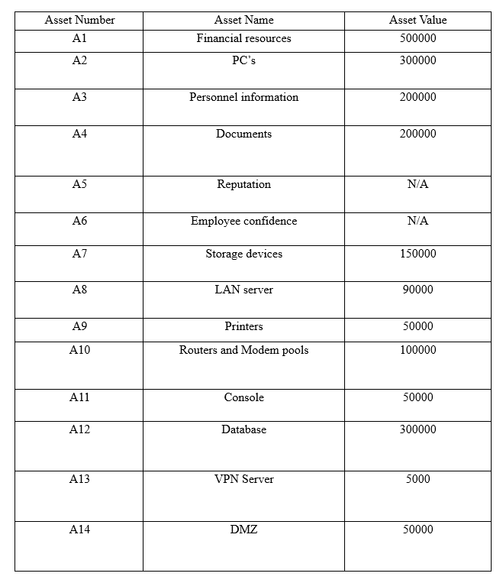
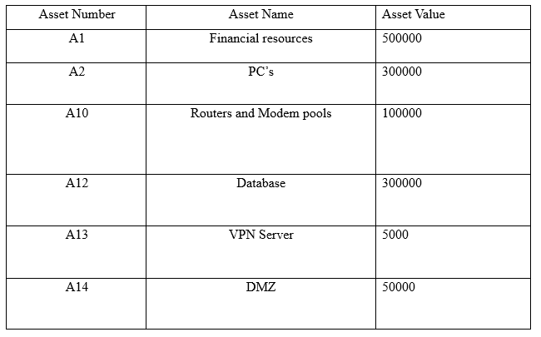
Assets

Slide 5
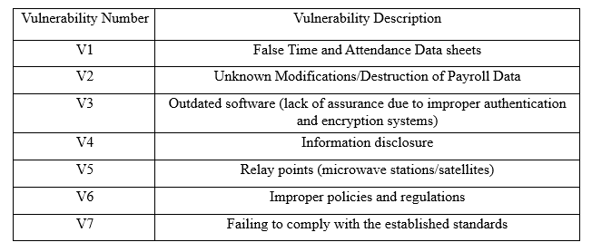
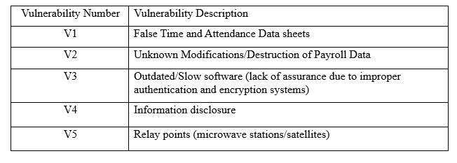
Vulnerabilities

Slide 6
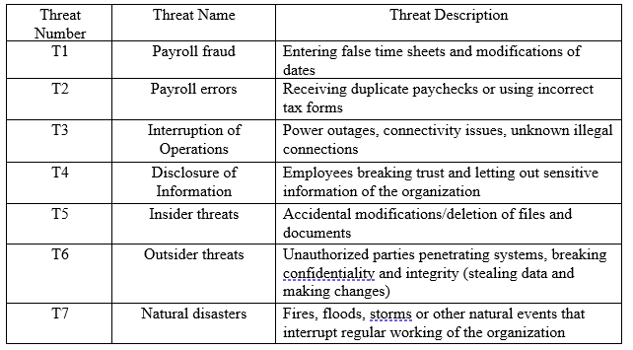
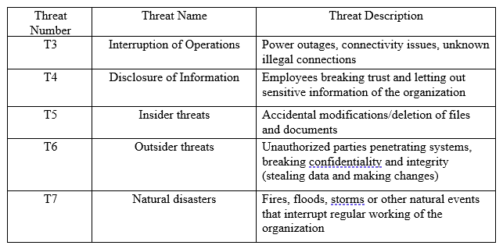
Threats

Slide 7
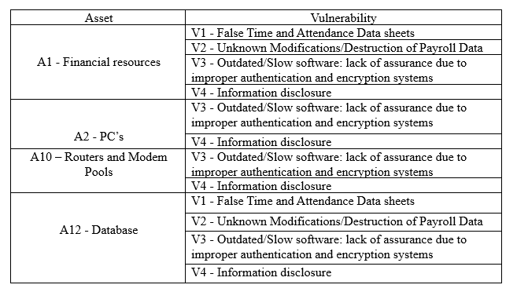
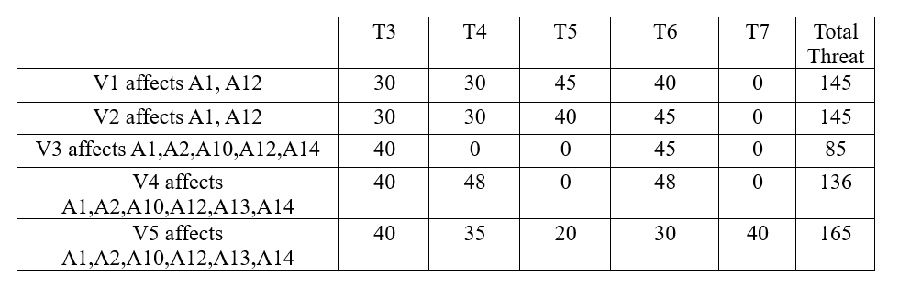
Asset impacts and Threat/Vulnerability pair

Slide 8
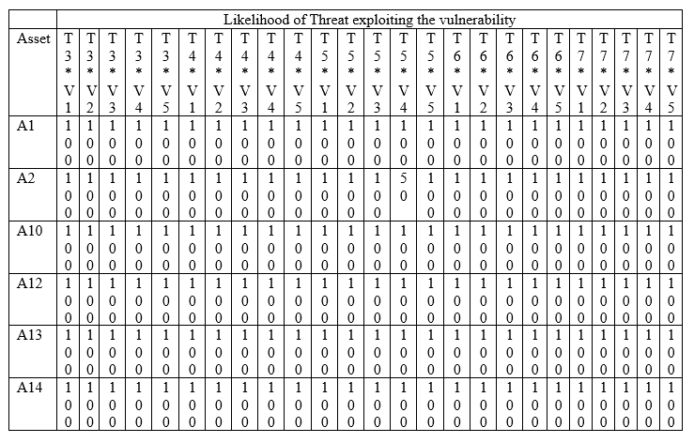
Probability of Exploitation

Slide 9
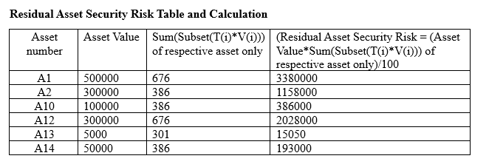
Preventive control - Initial Analysis
Residual Asset Security Risk = Asset Value*Sum(Subset(T(i)*V(i))) of respective asset only
Vulnerability Security Risk = ∑(Asset Value*Each Vulnerability’s total threat)/100
V1 = [(500000*145)+(300000*145)]/100 = 1160000
V2 = [(500000*145)+(300000*145)]/100 = 1160000
V3 = [(500000*85)+(300000*85)+(100000*85)+(300000*85)+(50000*85)]/100 = 1062500
V4 = [(500000*136)+(300000*136)+(100000*136)+(300000*136)+(5000*136)+(50000*136)]/100 = 1706800
V5 = [(500000*165)+(300000*165)+(100000*165)+(300000*165)+(5000*165)+(50000*165)]/100 = 2070750

Slide 10
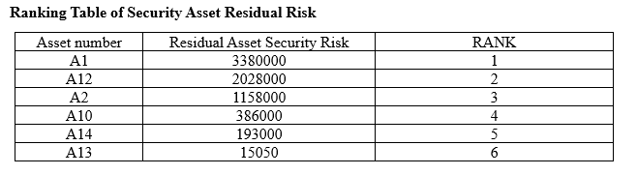
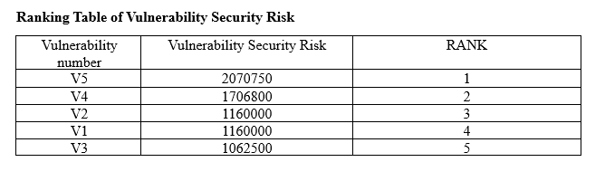
Ranking

Slide 11
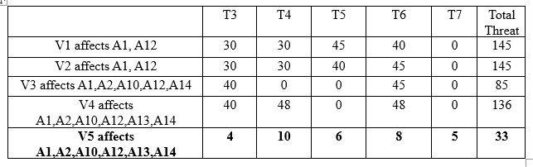
Applying Preventive Controls

Slide 12
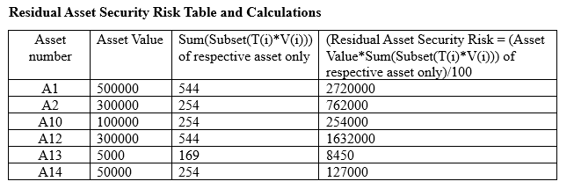
Residual Asset and Vulnerability Security Risk
V1 = [(500000*145)+(300000*145)]/100 = 1160000
V2 = [(500000*145)+(300000*145)]/100 = 1160000
V3 = [(500000*85)+(300000*85)+(100000*85)+(300000*85)+(50000*85)]/100 = 1062500
V4 = [(500000*136)+(300000*136)+(100000*136)+(300000*136)+(5000*136)+(50000*136)]/100 = 1706800
V5 = [(500000*33)+(300000*33)+(100000*33)+(300000*33)+(5000*33)+(50000*33)]/100 = 414150

Slide 13
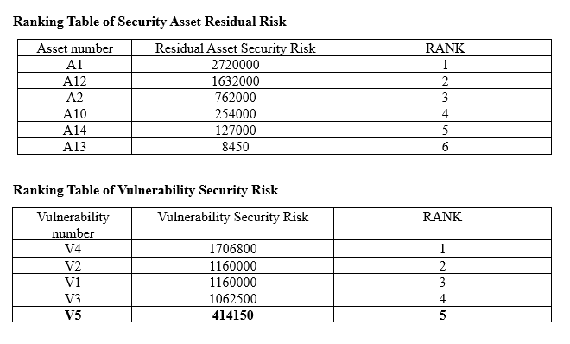
Ranking

Slide 14
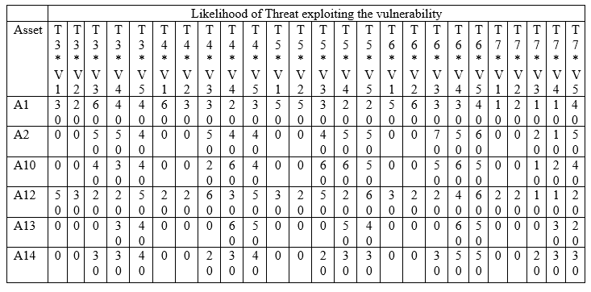
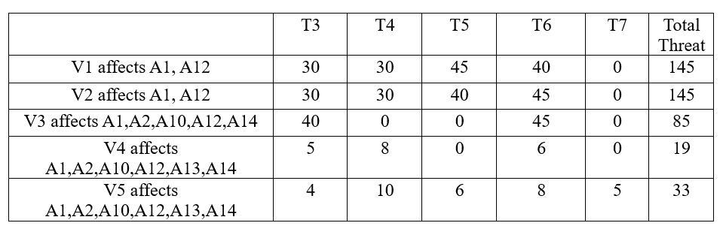
Responsive control - Initial Analysis

Slide 15
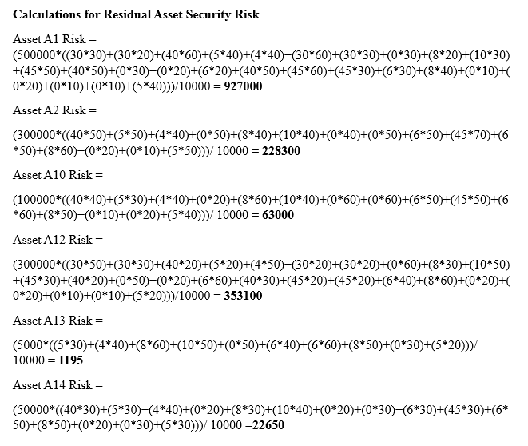
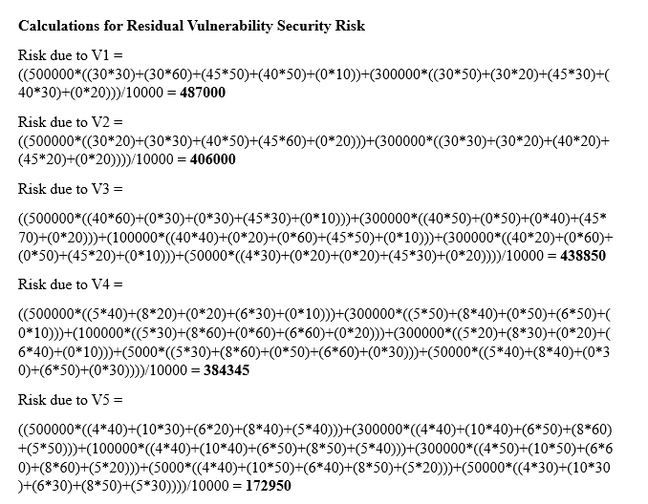
Residual Asset and Vulnerability Security Risk

Slide 16
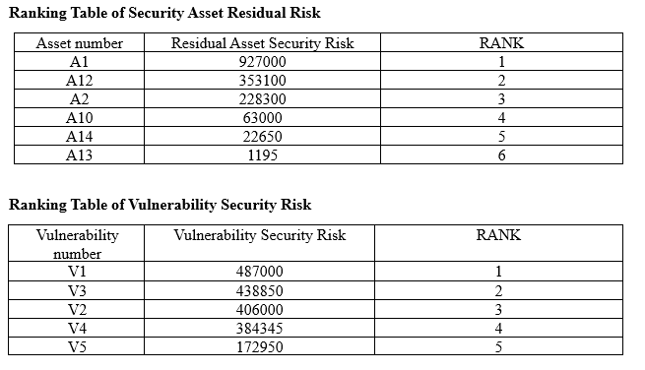
Ranking

Slide 17
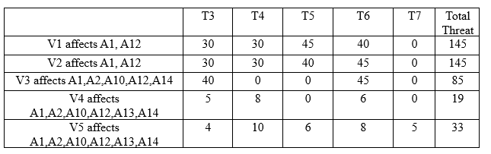
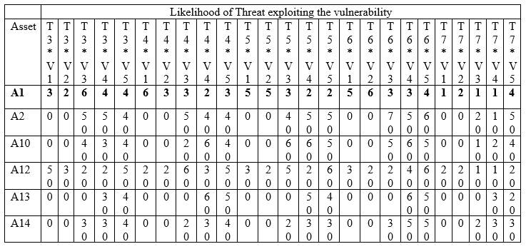
Applying Responsive controls

Slide 18
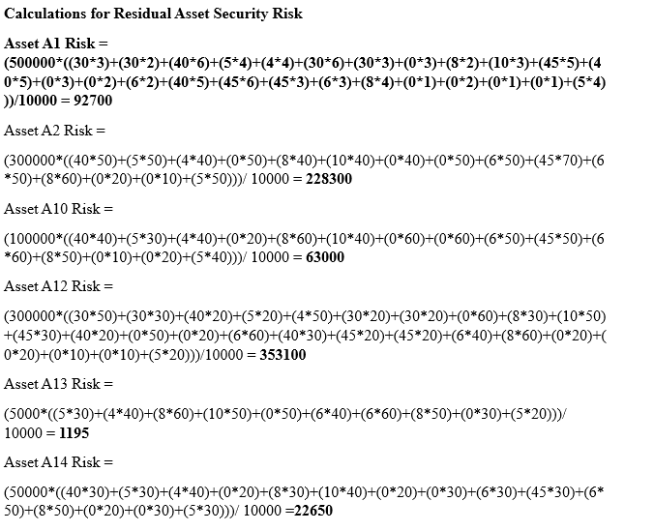
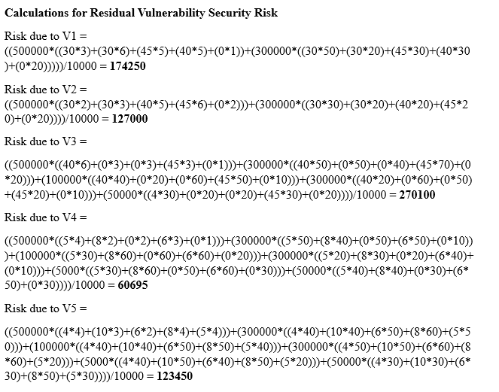
Residual Asset and Vulnerability Security Risk

Slide 19
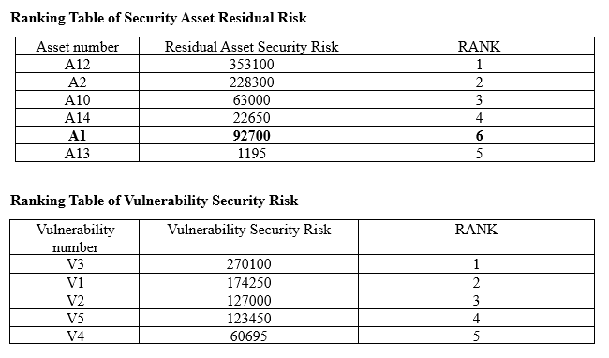
Ranking

Slide 20
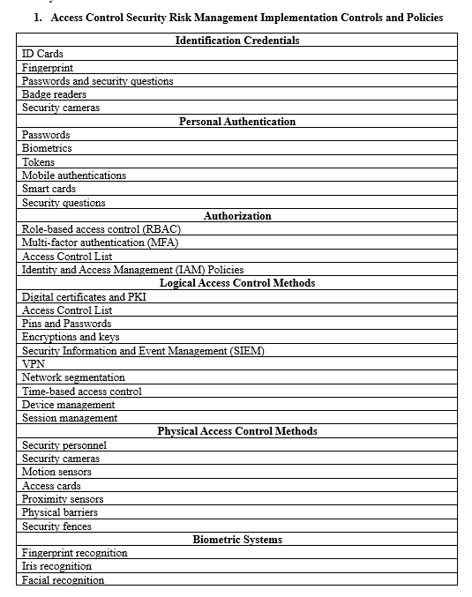
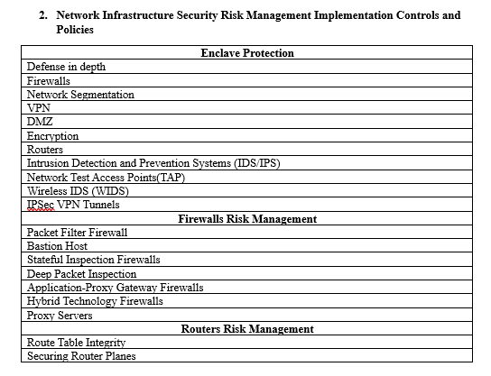
Implementation Plan

Slide 21
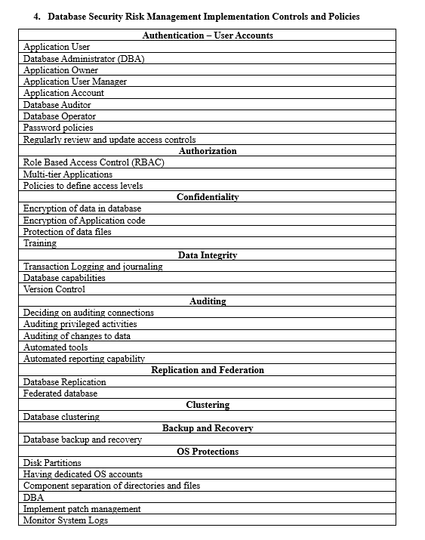
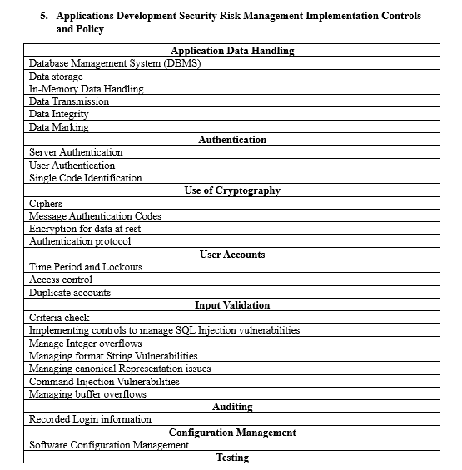

Slide 22
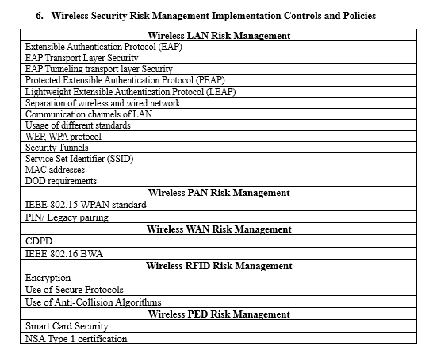

Slide 23
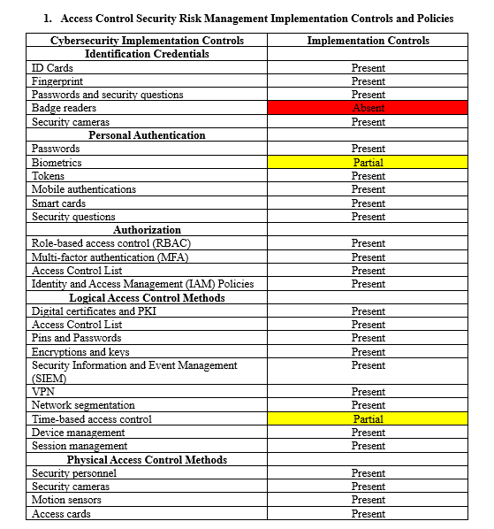
Comparison of the Implementation controls

Slide 24
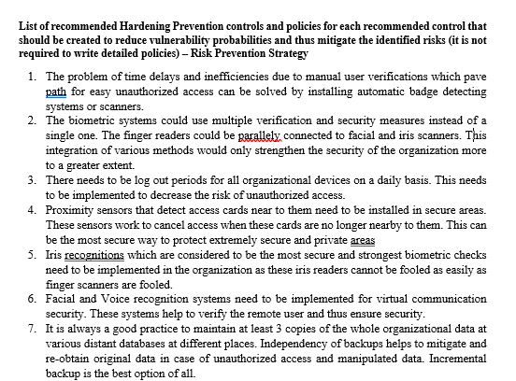
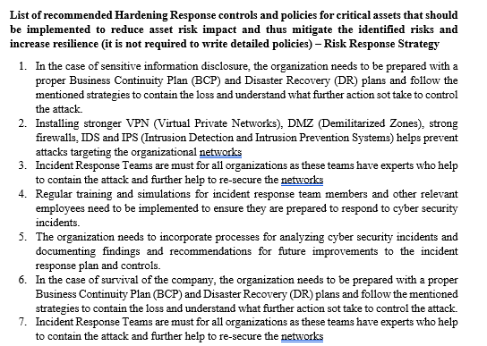
List Critical Assets
And thus, the potential Vulnerabilities
Also, the potential threats
Recommend Hardening Prevention controls Recommend Hardening Response controls
and so on.. and so on..

Slide 25
Questions?

